Slide 1

Chapter 4

Slide 2

x
i
y
i
Carry-in
c
i
Sum
s
i
Carry-out
c
i
+1
At the i^{th} stage:
Input:
c_{i} is the carry-in
Output:
s_{i} is the sum
c_{i+1} carry-out to (i+1)^{st}
state
0
0
0
0
0
0
0
1
1
0
0
1
0
1
0
0
1
1
0
1
1
0
0
1
0
1
0
1
0
1
1
1
0
0
1
1
1
1
1
1
s
i
=
x
i
y
i
c
i
+
x
i
y
i
c
i
+
x
i
y
i
c
i
+
x
i
y
i
c
i
=
x
i
⊕
y
i
⊕
c
i
c
=
y
i
c
i
+
x
i
c
i
+
x
i
y
i
i
+1
E
xample:
X
7
0
1
1
1
Carry-out
x
i
Carry-in
+
Y
=
+ 6
=
+
0
0
1
1
1
1
0
0
0
c
y
i
c
Z
13
1
1
0
1
i
+1
s
i
i
Legend for stage
i

Slide 3

Sum
Carry
y
i
c
i
x
i
y
s
x
i
c
i
i
c
i
i
+
1
c
i
x
x
i
y
i
y
i
i
c
i
+
1
Full adder
c
i
(F
A)
s
i
Full Adder (FA): Symbol for the complete circuit
for a single stage of addition.

Slide 4

Cascade n full adder (FA) blocks to form a n-bit adder.
Carries propagate or ripple through this cascade, n-bit ripple carry adder.
x
n
-
1
y
n
-
1
x
1
y
1
x
0
y
0
c
n
-
1
c
1
c
n
F
A
F
A
F
A
c
0
s
n
-
1
s
1
s
0
Most significant bit
Least significant bit
(MSB) position
(LSB) position
Carry-in c₀ into the LSB position provides a convenient way to
perform subtraction.

Slide 5
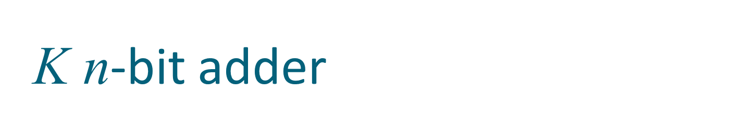
K n-bit numbers can be added by cascading k n-bit adders.
x
k
n
-
1
y
k
n
-
1
x
2
n
-
1
y
2
n
-
1
x
n
y
n
x
n
-
1
y
n
-
1
x
0
y
0
n
-
bit
n
-
bit
c
n
n
-
bit
c
k
n
adder
adder
adder
c
0
s
k
n
-
1
s
(
k
-
1
)
n
s
2
n
-
1
s
n
s
n
-
1
s
0
Each n-bit adder forms a block, so this is cascading of blocks.
Carries ripple or propagate through blocks, Blocked Ripple Carry Adder

Slide 6

Recall X – Y is equivalent to adding 2’s complement of Y to X.
2’s complement is equivalent to 1’s complement + 1.
X – Y = X + Y + 1
2’s complement of positive and negative numbers is computed similarly.
x
n
-
1
y
n
-
1
x
1
y
1
x
0
y
0
c
n
-
1
c
1
c
n
F
A
F
A
F
A
1
s
n
-
1
s
1
s
0
Most significant bit
Least significant bit
(MSB) position
(LSB) position

Slide 7

y
n
-
1
y
1
y
0
Add/Sub
control
x
n
-
1
x
1
x
0
c
n
-bit adder
n
c
0
s
n
-
1
s
1
s
0
Add/sub control = 0, addition.
Add/sub control = 1, subtraction.

Slide 8


Detecting overflows
Overflows can only occur when the sign of the two operands is the same.
Overflow occurs if the sign of the result is different from the sign of the operands.
Recall that the MSB represents the sign.
  x_{n-1}, y_{n-1}, s_{n-1} represent the sign of operand x, operand y and result s respectively.
Circuit to detect overflow can be implemented by the following logic expressions:

Slide 9

x₀
y₀
Consider 0th stage:
c₁ is available after 2 gate delays.
s₁ is available after 1 gate delay.
c₁
FA
c₀
s₀
Sum
Carry
y
i
c
i
x
i
y
s
x
i
c
i
i
c
i
i
+
1
c
i
x
y
i
i

Slide 10

Cascade of 4 Full Adders, or a 4-bit adder
x₀
y₀
x₀
y₀
x₀
y₀
x₀
y₀
FA
FA
FA
c₁
FA
c₀
c₄
c₃
c₂
s₃
s₂
s₁
s₀
s₀ available after 1 gate delays, c₁ available after 2 gate delays.
s₁ available after 3 gate delays, c₂ available after 4 gate delays.
s₂ available after 5 gate delays, c₃ available after 6 gate delays.
s₃ available after 7 gate delays, c₄ available after 8 gate delays.
For an n-bit adder, s_{n-1} is available after 2n-1 gate delays
c_{n} is available after 2n gate delays.

Slide 11

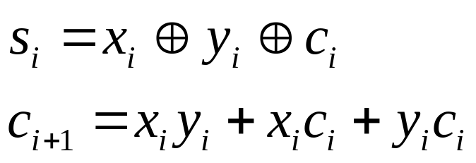
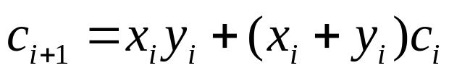
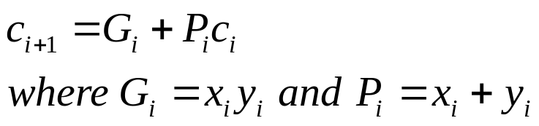
Recall the equations:
Second equation can be written as:
We can write:
G_{i} is called generate function and P_{i} is called propagate function
G_{i} and P_{i} are computed only from x_{i} and y_{i} and not c_{i}, thus they can
be computed in one gate delay after X and Y are applied to the
inputs of an n-bit adder.

Slide 12

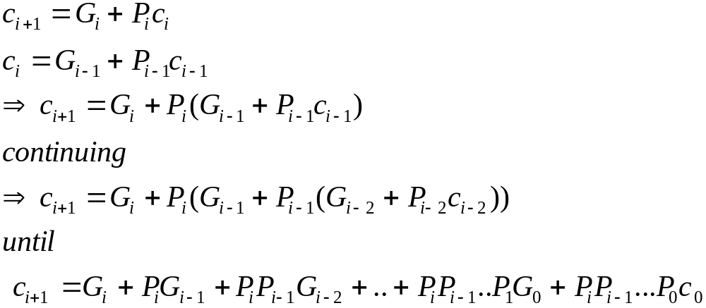
All carries can be obtained 3 gate delays after X, Y and c₀ are applied.
-One gate delay for P_{i} and G_{i}
-Two gate delays in the AND-OR circuit for c_{i+1}
All sums can be obtained 1 gate delay after the carries are computed.
Independent of n, n-bit addition requires only 4 gate delays.
This is called Carry Lookahead adder.

Slide 13

x
3
y
3
x
2
y
2
x
1
y
1
x
0
y
0
.
4-bit
carry-lookahead
adder
c
c
3
c
2
c
1
c
4
B cell
B cell
B cell
B cell
0
s
3
s
2
s
1
s
0
G
3
P
3
G
2
P
2
G
1
P
1
G
0
P
0
Carry-lookahead logic
x
i
y
i
.
.
.
c
i
B-cell for a single stage
B cell
G
i
P
i
s
i

Slide 14
Carry lookahead adder (contd..)
Performing n-bit addition in 4 gate delays independent of n is good only theoretically because of fan-in constraints.
Last AND gate and OR gate require a fan-in of (n+1) for a n-bit adder.
  For a 4-bit adder (n=4) fan-in of 5 is required.
  Practical limit for most gates.
In order to add operands longer than 4 bits, we can cascade 4-bit Carry-Lookahead adders. Cascade of Carry-Lookahead adders is called Blocked Carry-Lookahead adder.
c
=
G
+
P
G
+
P
P
G
+
..
+
P
P
..
P
G
+
P
P
...
P
c₀
i
+
1
i
i
i
−
1
i
i
−
1
i
−
2
i
i
−
1
1
0
i
i
−
1
0

Slide 15

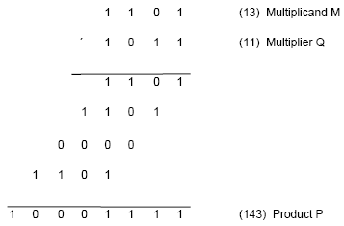
Product of 2 n-bit numbers is at most a 2n-bit number.
Unsigned multiplication can be viewed as addition of shifted
versions of the multiplicand.

Slide 16
Multiplication of unsigned numbers (contd..)
We added the partial products at end.
  Alternative would be to add the partial products at each stage.
Rules to implement multiplication are:
  If the i^{th} bit of the multiplier is 1, shift the multiplicand and add the shifted multiplicand to the current value of the partial product.
  Hand over the partial product to the next stage
  Value of the partial product at the start stage is 0.

Slide 17
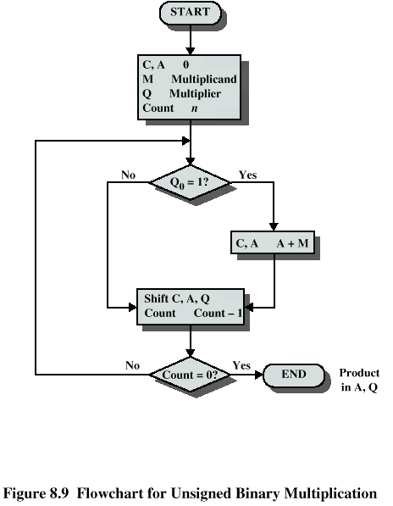

Slide 18

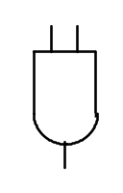
Typical multiplication cell
Bit of incoming partial product (PPi)
j^{th} multiplicand bit
i^{th} multiplier bit
i^{th} multiplier bit
carry out
FA
carry in
Bit of outgoing partial product (PP(i+1))

Slide 19
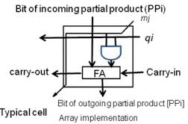

Slide 20

Combinatorial array multiplier
Multiplicand
(PP0)
0
m
3
0
m
2
0
m
1
0
m
0
q
0
PP1
0
q
p
0
0
1
PP2
p
Multiplier
q
2
1
0
PP3
p
2
q
3
0
p
p
p
p
p
,
7
6
5
4
3
Product is: p₇,p₆,..p₀
Multiplicand is shifted by displacing it through an array of adders.

Slide 21
Combinatorial array multiplier (contd..)
Combinatorial array multipliers are:
  Extremely inefficient.
  Have a high gate count for multiplying numbers of practical size such as 32-bit or 64-bit numbers.
  Perform only one function, namely, unsigned integer product.
Improve gate efficiency by using a mixture of combinatorial array techniques and sequential techniques requiring less combinational logic.

Slide 22
Sequential multiplication
Recall the rule for generating partial products:
  If the ith bit of the multiplier is 1, add the appropriately shifted multiplicand to the current partial product.
  Multiplicand has been shifted left when added to the partial product.
However, adding a left-shifted multiplicand to an unshifted partial product is equivalent to adding an unshifted multiplicand to a right-shifted partial product.

Slide 23

Register A (initially 0)
Shift right
C
a
n
-
1
a
q
q
0
n
-
1
0
Multiplier Q
Add/Noadd
control
n-bit
Adder
MUX
Control
sequencer
0
0
m
n
-
1
m
0
Multiplicand M

